Slide 1

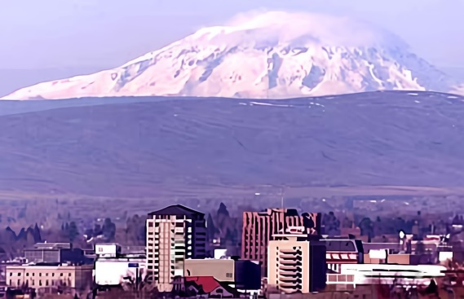

Assessment of Downtown Parking
Summary Presentation
September 13, 2022
8:00 AM

Slide 2

Project Objectives
Assess use of downtown parking supply
Development hypothetical revenue/expense models (assuming the outcomes of a potential paid parking environment), and
Provide a framework for more comprehensive approach to downtown parking management.

Slide 3
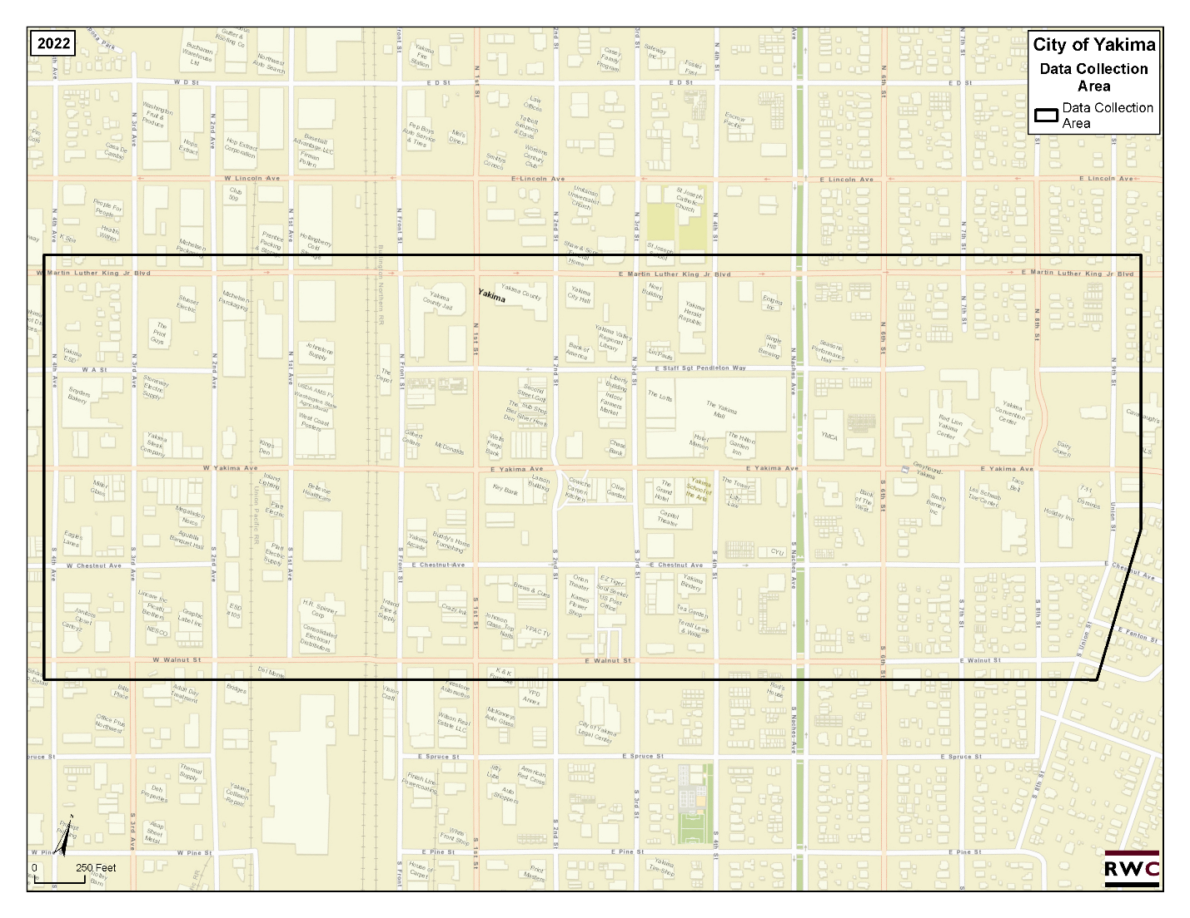
Study Area
(on-street)
MLK (north)
Walnut ST. (south)
9th ST./Nelson (east)
4th Ave (west)
1,926 on-street stalls

Slide 4
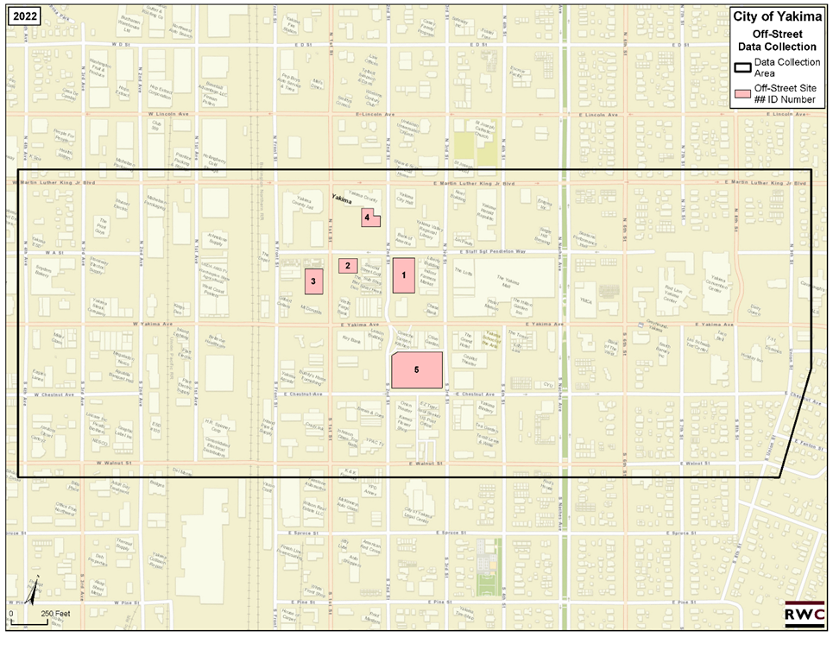
Study Area
(off-street)
Lot 1: 122 stalls (2nd Street Grill)
Lot 2: 39 stalls (behind Grill)
Lot 3: 61 stalls (Crafted Restaurant)
Lot 4: 24 stalls (114 N 2nd Street)
Lot 5: 183 stalls (Millennium Plaza City Lot)
429 off-street stalls

Slide 5

Data Collection Process
Data was recorded once per hour from 8:00 AM to 6:00 PM (enforcement hours).
Data collected by City staff in different time frames on multiple weekdays.
  April 18, 19, 20, 21 and 22, 2022.
Data was collected on two Saturdays to help inform weekend parking trends
  April 23 and April 30, 2022.
  Summarized by block face and by off-street site.

Slide 6
Data Findings - Hourly
On-street
Low Use
11AM Peak Hour (49%)
Off-street
Robust use
Noon Peak Hour (82%)

Slide 7
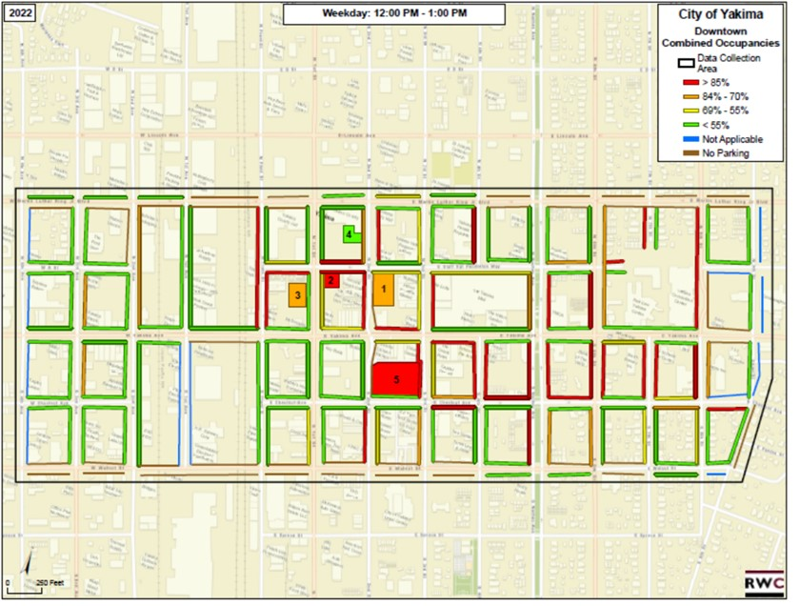
Data Findings – Peak Hour
A
B
C

Slide 8
Data Summary
Heat maps indicate there are pockets of higher demand (particularly on the weekday) when the downtown is viewed at a more granular level.
The parking system is much more robust in the sub-area B of downtown
  N/S Front Street (west), N/S Naches Avenue (east), E. Walnut Street (south), and E. Martin Luther King, Jr., Blvd (north).
On the weekday, 77% of all constrained block faces in the larger study area clustered in sub-area B.
  Sub-area C has higher concentrated activity.
  Sub-area A very low use.
A
B
C

Slide 9
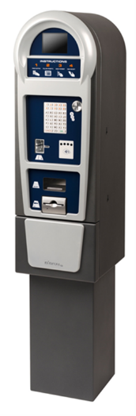
Cost/Revenue Analysis – Pay-to-Park
Model is conservative and includes 20% leakage factor.
Rates of $0.75, $1.00, and $1.25 per hour yield positive annual net revenue in the first five years of operation, but a rate of $0.50 per hour would yield negative revenue.
Expanding the study area east to 9th Avenue reduces net revenue by more than $100,000 per year (at a rate of $1 per hour) compared to the model iteration bounded by S. 8th Ave (east).

Slide 10

Parking Management Strategies for Consideration
Eliminate no-limit on-street parking stalls on commercial streets within the study area boundary. Replace with time limited stalls.
  978/1,926 on-street stalls are currently No Limit (51%)
Establish time limit standards based on demand in “Parking Management Sub-Areas.”
  3 hours (Sub-Area A)
  2 Hours (Sub-Area B)
  3 Hours (Sub-Area C)
Establish monthly parking permit rates to actual demand by off-street site.

Slide 11
Parking Management Strategies for Consideration
Consider implementing pay-to-park on-street in sub-areas B (Core) and C (west)
With Strategy d, implement pay-to-park off-street in Lots 1 – 5, to allow visitor payment for use.
f. Establish Parking Services as an Enterprise Fund
g. Operate parking associated with the Convention Center as a separate business center within Convention Center operations.

Slide 12

Questions and Discussion

Slide 13

THANK YOU

